Slide 1
CHM 5681
Emission Quantum Yield
Source
Detector
# of photons out
Φ_{(em)} =
hν
# of photons in
Sample

Slide 2
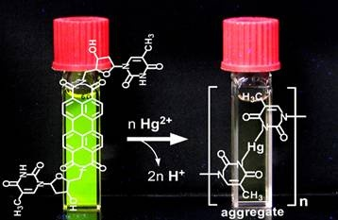
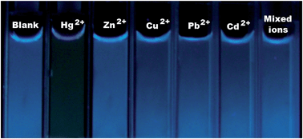
High Efficiency Emitters
Metal Ion Sensing

Slide 3
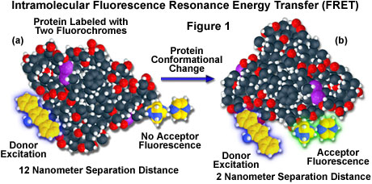
High Efficiency Emitters

Slide 4
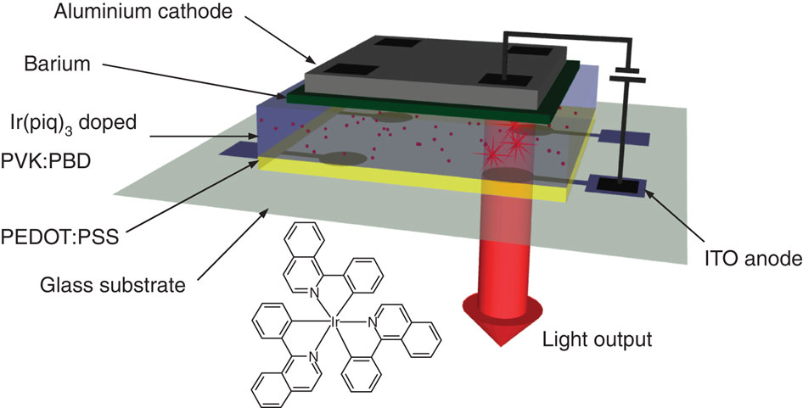


High Efficiency Emitters
OLED

Slide 5
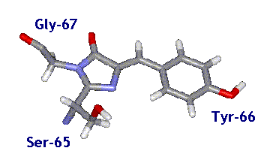
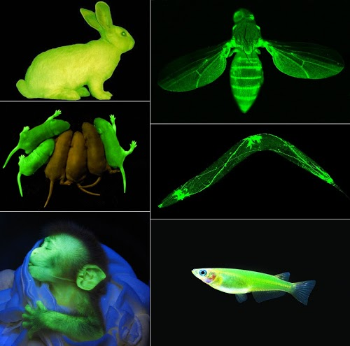
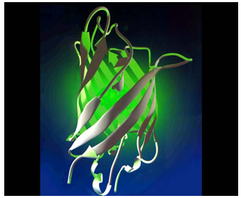
High Efficiency Emitters
Expression Studies
4-(p-hydroxybenzylidene)- imidazolidin-5-one
Green Fluorescent Protein
Notes:
Beta barrel

Slide 6
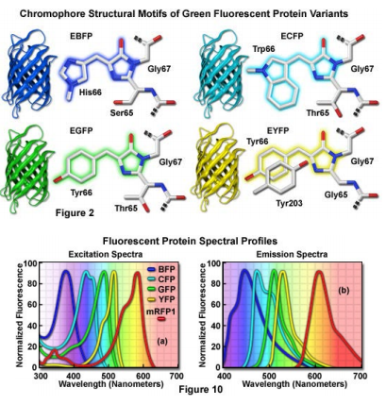
High Efficiency Emitters

Slide 7


High Efficiency Emitters
http://www.glofish.com/

Slide 8
Emission Quantum Yield
Source
Emission Quantum Yield (Φ)
Detector
hν
Φ =
# of photons emitted
# of photons absorbed
Sample
Ground State
(S₀)
Singlet Excited State (S₁)
hν
hν

Slide 9
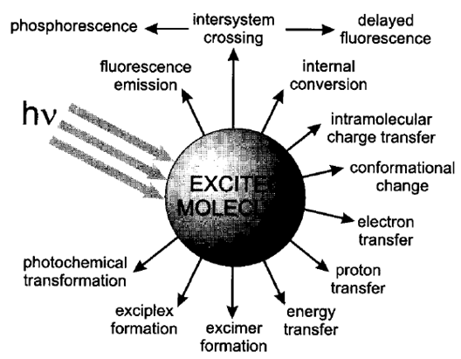
Excited State Decay
Radiative Decay
Excitation
Non-emissive Decay
Non-radiative Decay
Φ =
# of photons emitted
# of photons absorbed

Slide 10
Excited State Decay
Reaction Kinetics
k_{A}
k_{r} + k_{nr}
S₁
S₀
S₁
S₀
k_{A}
k_{nr}
k_{r}
If it is assumed that all processes are first order with respect to number densities of S₀ and S₁ (n_{S0} and n_{S1} in molecules per cm³)
Energy
Then the rate Equation:
S₀
k_{A} = excitation rate
k_{r} = radiative rate
k_{nr} = non-radiative rate

Slide 11
Excited State Decay
S₁
Rate equation:
k_{A}
k_{nr}
k_{r}
Energy
Sample is illuminated with photons of constant intensity, a steady-state concentration of S₁ is rapidly achieved.
dn_{S1}/dt = 0
S₀
k_{A} = excitation rate
k_{r} = radiative rate
k_{nr} = non-radiative rate
Substitution for photon flux and the relationship between k_{A} and k_{r} then (math happens):
Φ = Emission Quantum Yield

Slide 12
Quantum Yield
# of photons emitted
=
# of photons absorbed
k_{r}
k_{nr}

Slide 13
Non-radiative Rates
k_{r}
Φ_{F} =
k_{r} + k_{nr}
k_{r}
Φ_{F} =
k_{r} + k_{chem} + k_{dec} + k_{ET} + k_{et} + k_{pt} + k_{tict} + k_{ic} + k_{isc} …
Rate constants:
k_{r} = radiative
k_{chem} = photochemistry
k_{dec} = decomposition
k_{ET} = energy transfer
k_{et} = electron transfer
k_{PT} = proton transfer
k_{tict} = twisted-intramolecular charge transfer
k_{ic} = internal conversion
k_{isc} = intersystem crossing

Slide 14
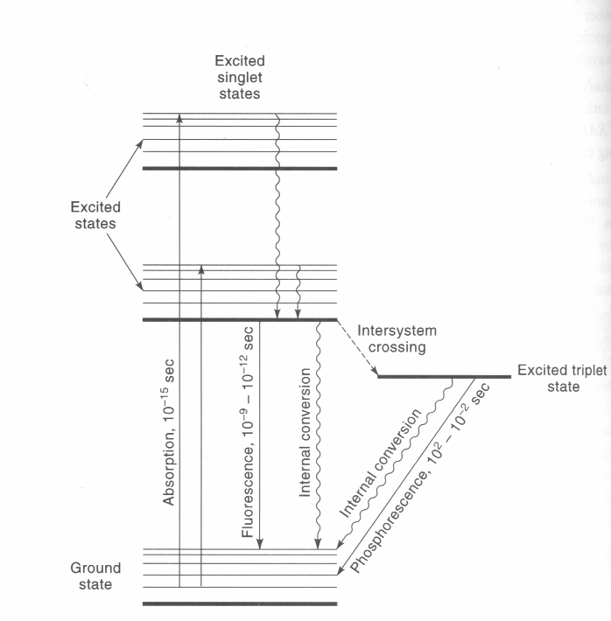
Emission Quantum Yield
Quantum Yield:

Slide 15

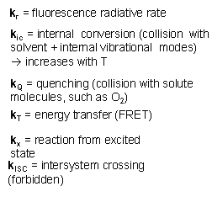
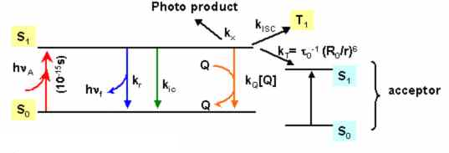
Emission Quantum Yield

Slide 16
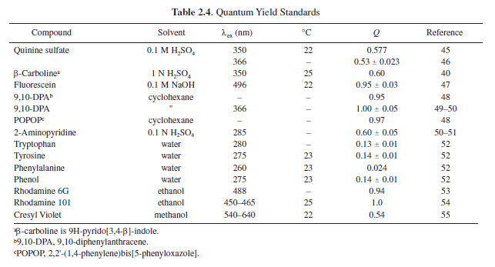
Emission Quantum Yield
Φ =
# of photons emitted
= 0 to 1
# of photons absorbed

Slide 17
Fluorescence Quantum Yield
k_{r}
Φ_{F} =
k_{r} + k_{chem} + k_{dec} + k_{ET} + k_{et} + k_{pt} + k_{tict} + k_{ic} + k_{isc} …
1) Internal conversion (k_{ic})
  -non radiative loss via collisions with solvent or via internal vibrations.
2) Quenching
  -interaction with solute molecules capable of quenching excited state
  (k_{chem,} k_{dec,} k_{ET,} k_{et} )
3) Intersystem Crossing Rate
4) Temperature
- Increasing the temperature will increase of dynamic quenching
5) Solvent
- viscosity, polarity, and hydrogen bonding characteristics of the solvent
-Increased viscosity reduces the rate of bimolecular collisions
6) pH
- protonated or unprotonated form of the acid or base may be fluorescent
7) Energy Gap Law

Slide 18
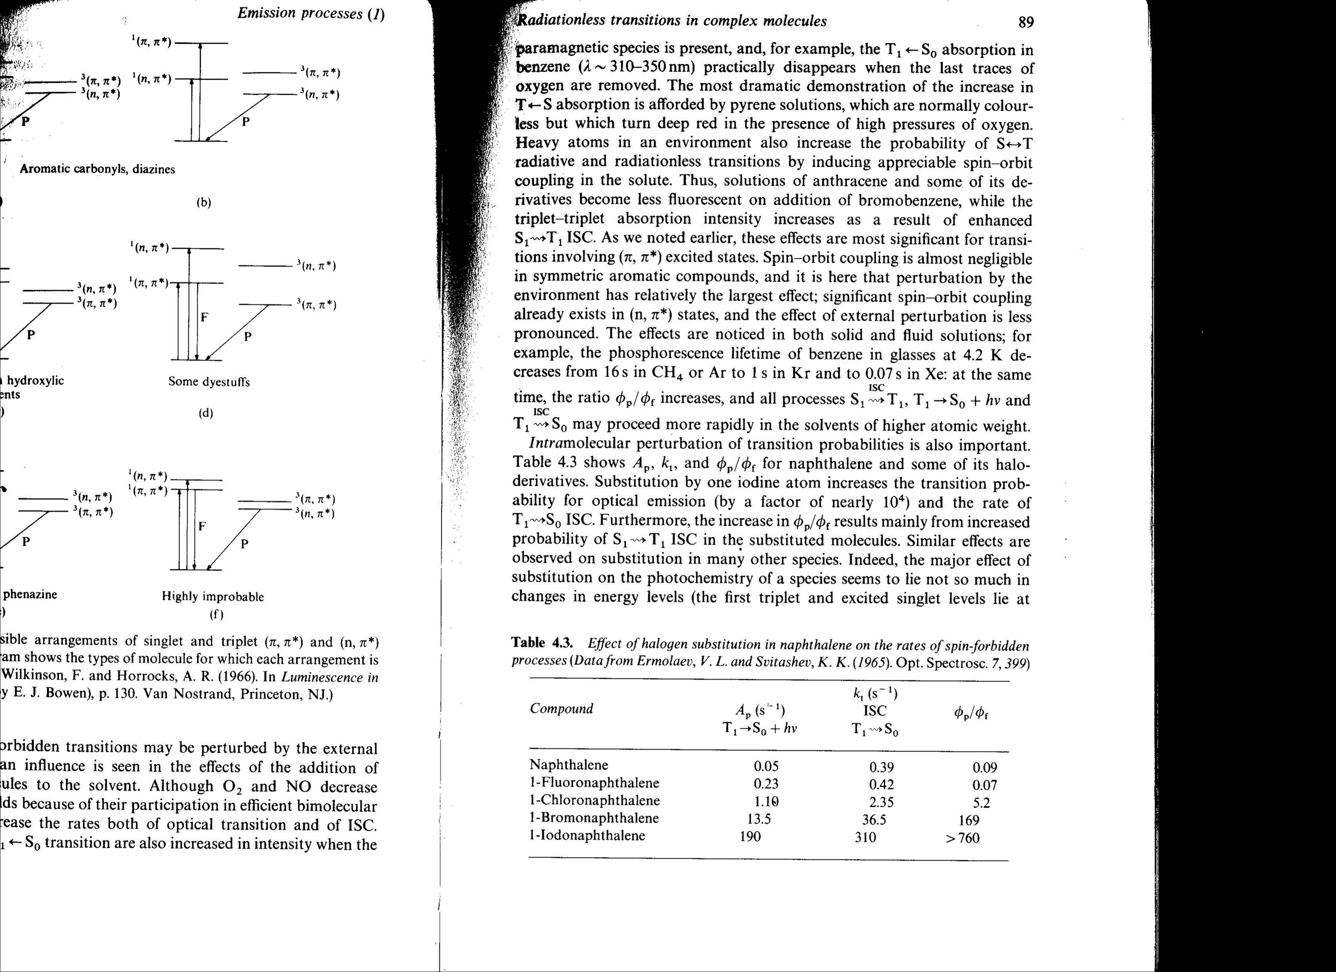
Intersystem Crossing
S₁
T₂
E
T₁
S₀
Excitation
Fluorescence
Intersystem Crossing
Phosphorescence
Increase in strength of spin-orbit interaction
Atom Size
ISC
Φ_{Fluorescence}
Φ_{Phosphorescence}

Slide 19
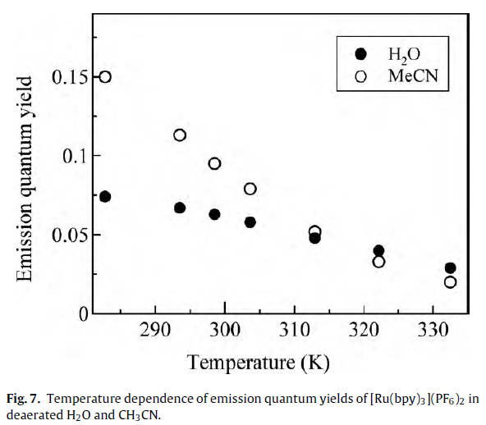
Temperature Dependence

Slide 20
Measuring Quantum Yield
Source
Detector
hν
Sample
# of photons emitted
=
# of photons absorbed
We don’t get to directly measure Φ, k_{r} or k_{nr}!
We do measure transmittance and emission intensity.

Slide 21
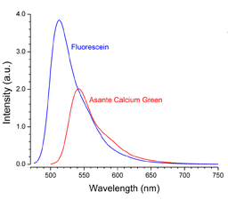
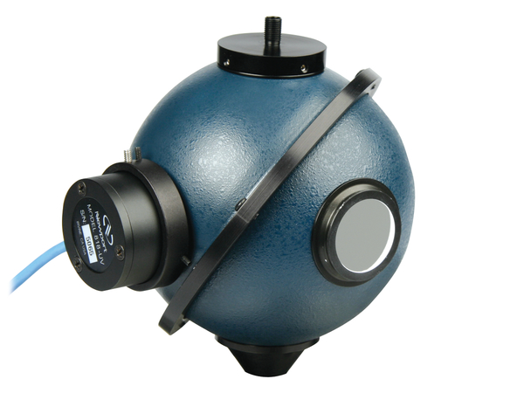
Measuring Quantum Yield
Relative Quantum Yield
“Absolute” Quantum Yield

Slide 22
Relative Quantum Yield
# of photons emitted
=
# of photons absorbed
I_{f} is proportional to the amount of the radiation from the excitation source that is absorbed and Φ_{f} .
Ι_{f} = Φ_{f} Ι₀ (1-10^{-A})
I_{f} = emission intensity
Φ_{f} = quantum yield
I₀ = incident light intensity
Α = absorbance
I_{f} ∝ Φ_{f}
I_{f} ∝ A

Slide 23
Relative Quantum Yield
Φ_{f} ∝ I_{f}
Ι_{f} = Φ_{f} Ι₀ (1-10^{-A})
I_{f} ∝ A
Compare sample (S) fluorescence to reference (R).
Φ_{S}
Ι_{S}
(1-10^{-AR})
n_{S}²
=
x
x
Φ_{R}
Ι_{R}
(1-10^{-AS})
n_{R}²
Known
Reported
Measured
Φ = quantum yield
I = emission intensity
A = absorbance
n = refractive index

Slide 24
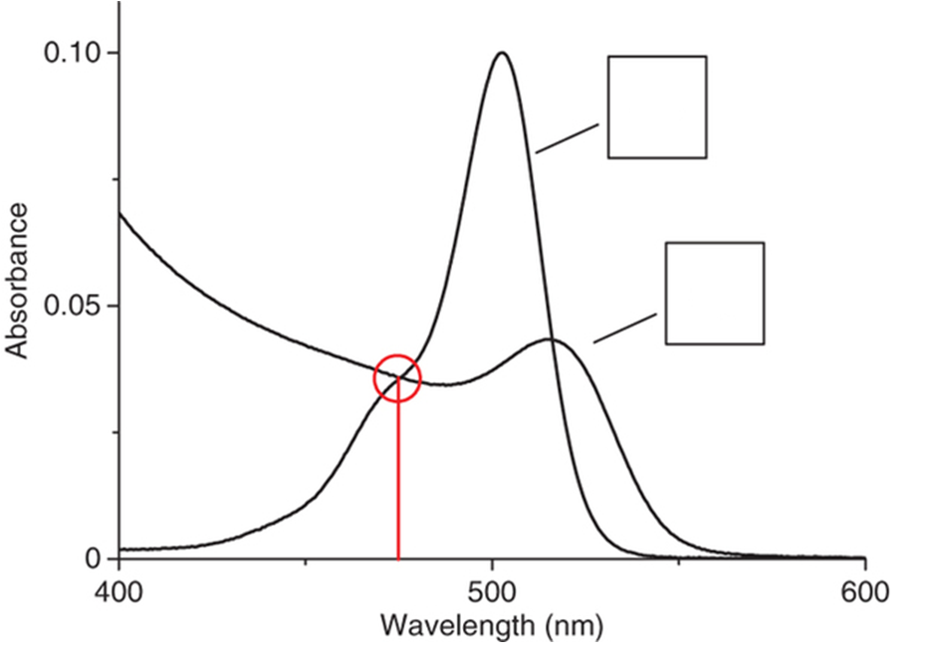
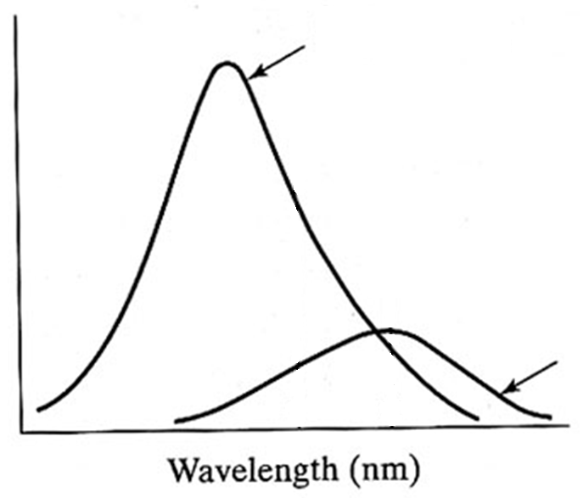
Relative Quantum Yield
Φ_{S}
Ι_{S}
(1-10^{-AR})
n_{S}²
=
x
x
Φ_{R}
Ι_{R}
(1-10^{-AS})
n_{R}²
Absorption
Emission
Reference Emission
A_{R}
A_{S}
I
Sample Emission
Same instrument settings:
excitation wavelength, slit widths, photomultiplier voltage…

Slide 25
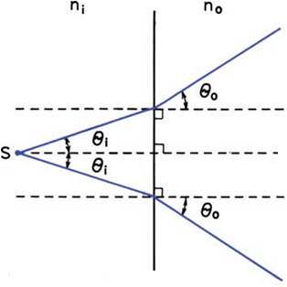
Relative Quantum Yield
Φ_{S}
Ι_{S}
(1-10^{-AR})
n_{S}²
=
x
x
Φ_{R}
Ι_{R}
(1-10^{-AS})
n_{R}²
?
Excitation
Snell’s Law:
Sinθ_{i}
n_{i}
=
Sinθ_{o}
n_{o}
Detector
Emission
n_{S}²
Sinθ_{i}²
=
n_{R}²
Sinθ_{o}²

Slide 26
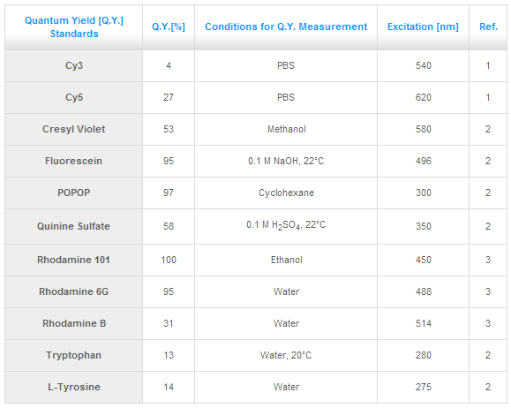
References

Slide 27
Relative Quantum Yield
Emission
Detector
Absorption
Detector
Source
I_{F}
P₀
P
Sample
Reflectance
Scatter
Φ_{S}
Ι_{S}
(1-10^{-AR})
n_{S}²
=
x
x
Φ_{R}
Ι_{R}
(1-10^{-AS})
n_{R}²

Slide 28
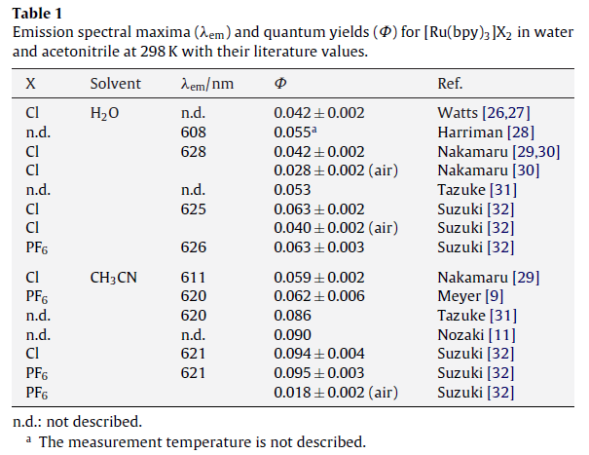
Relative Quantum Yield
[Ru(bpy)₃] 2Cl
in H₂O
Φ = 0.042-0.063
[Ru(bpy)₃] 2PF₆
in MeCN
Φ = 0.062-0.095

Slide 29
Relative Quantum Yield
Φ_{S}
Ι_{S}
(1-10^{-AR})
n_{S}²
=
x
x
Φ_{R}
Ι_{R}
(1-10^{-AS})
n_{R}²
Minimizing Error:
Sample/Reference with similar:
- Emission range
- Quantum yield
Same Solvent
Known Standard
Same Instrument Settings
- Excitation wavelength
- Slit widths
- PMT voltage

Slide 30
Measuring Quantum Yield
Relative Quantum Yield
“Absolute” Quantum Yield

Slide 31
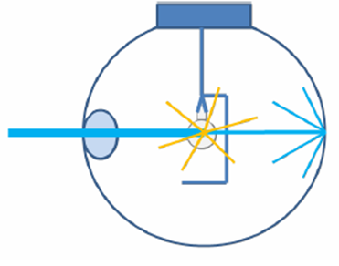
Absolute Quantum Yield
Φ =
# of photons emitted
# of photons absorbed
Source
Detector
Integrating Sphere

Slide 32
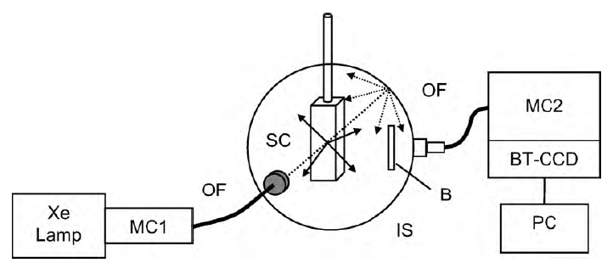
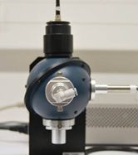
Absolute Quantum Yield
Hamamatsu: C9920-02
(99% reﬂectance for wavelengths from 350 to 1650 nm and over 96% reflectance for wavelengths from 250 to 350 nm)
Fig. 2. Schematic diagram of integrating sphere (IS) instrument for measuring absolute fluorescence quantum yields. MC1, MC2: monochromators, OF: optical fiber, SC:
sample cell, B: buffle, BT-CCD: back-thinned CCD, PC: personal computer.

Slide 33
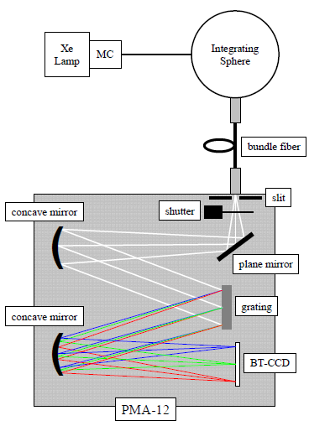
Absolute Quantum Yield
Full Spectrum

Slide 34
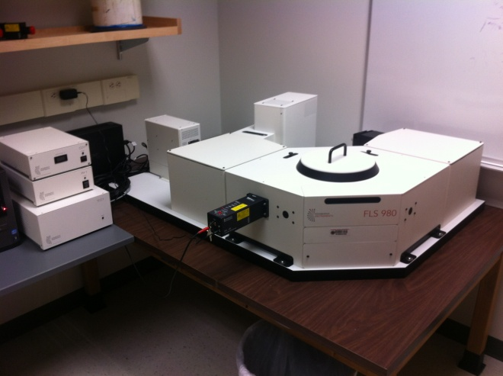
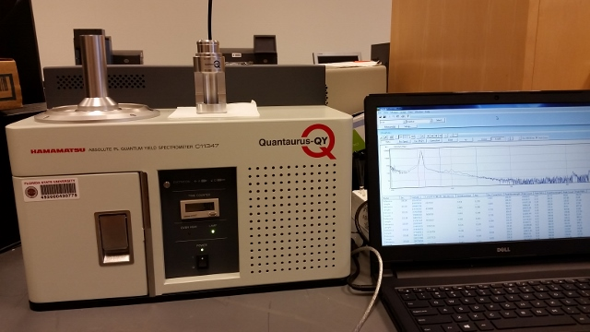
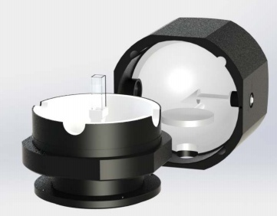
Instrumentation
Hamamatsu Quantaurus-QY Spectrometer
Edinburgh FLS980
MAC Lab
CSL 116
Hanson Group
CSL 5306
150 W Xenon arc lamp
250-850 nm excitation
CCD detector (200-950 nm)
450 W Xenon arc lamp
250-900 nm excitation
PMT detector (300-850 nm)

Slide 35
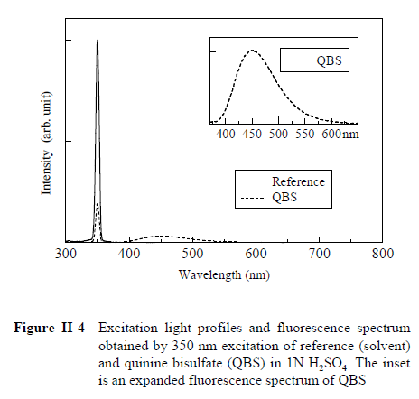

Data Acquisition
Set excitation λ
Insert reference
  - holder + solvent
Irradiate Reference
Detect output across
- excitation and emission
5) Insert Sample
  Holder + solvent + sample
6) Repeat 3 and 4

Slide 36
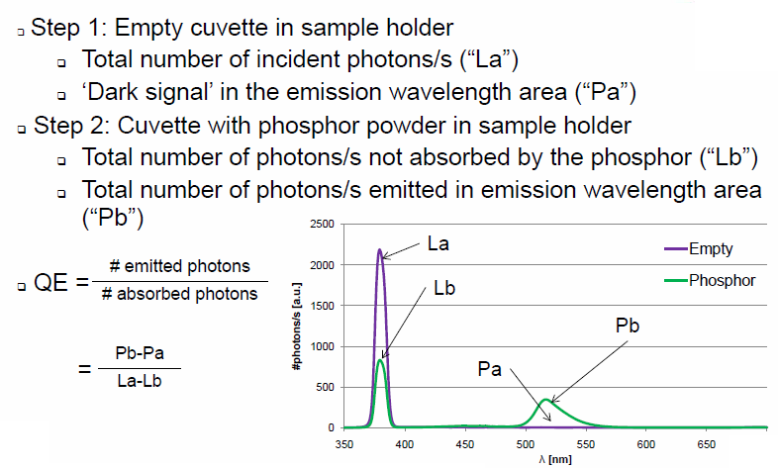
Absolute Quantum Yield

Slide 37
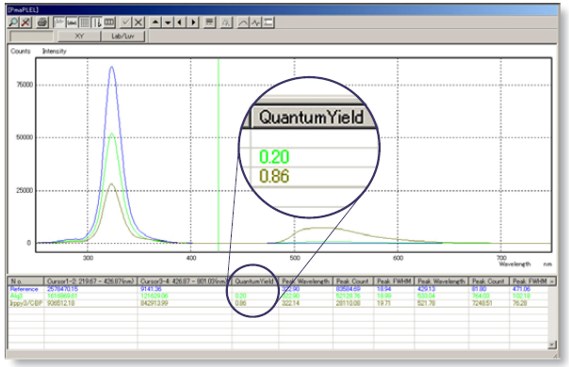
Absolute Quantum Yield

Slide 38
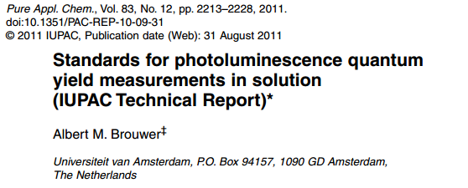
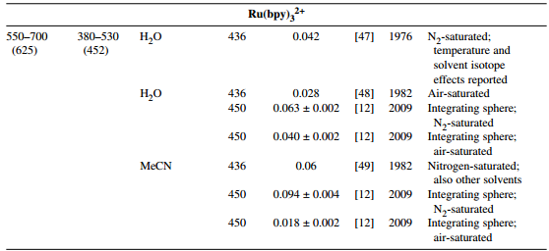

Slide 39
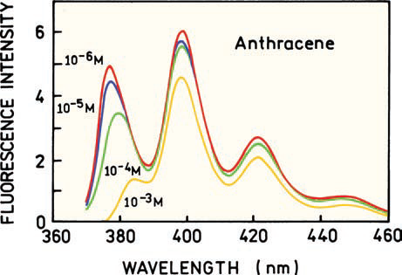
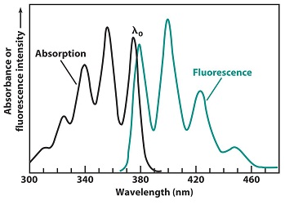
Self Absorption/Filter Effect
Anthracene

Slide 40
Self Absorption/Filter Effect
Inner filter effect
Fluorescence intensity
Ι_{f} = Φ_{f} Ι₀ (1-10^{-A})
Concentration (M)
Φ_{S}
Ι_{S}
(1-10^{-AR})
n_{S}²
=
x
x
Φ_{R}
Ι_{R}
(1-10^{-AS})
n_{R}²

Slide 41
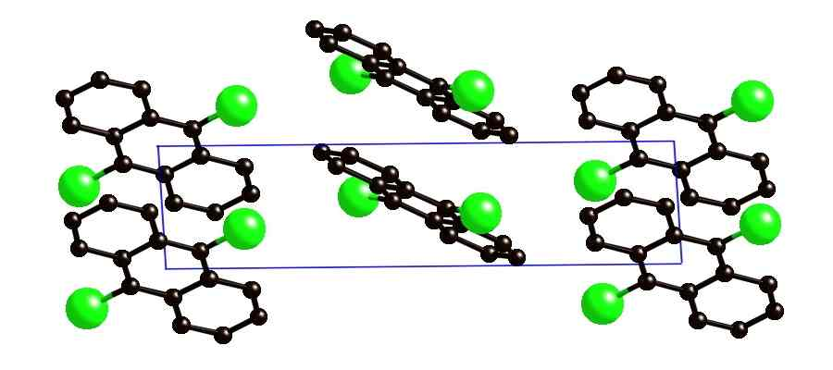
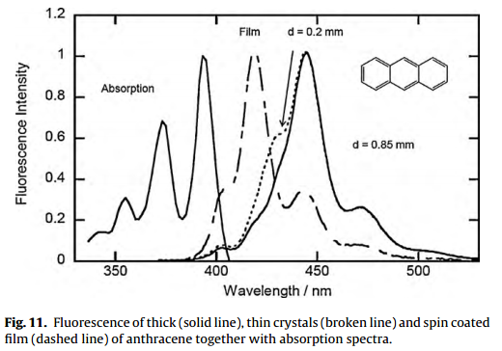
Single Crystal Measurements

Slide 42
Quantum Yield and Lifetime
Substitution for photon flux and the relationship between k_{A} and k_{r} then (math happens):
Intrinsic or natural lifetime (τ_{n}):
lifetime of the fluorophore in the absence of non-radiative processes
1
τ_{n} =
k_{r}
Radiative Rate and Extinction Coefficient:
Extinction Coefficient
k_{r}
=
Radiative Rate
^{τn}

Slide 43
Relationship between absorption intensity and fluorescence lifetime
Strickler and Berg “Relationship between Absorption Intensity and Fluorescence Lifetime of Molecules” J. Chem. Phys. 1962, 37, 814.
Strickler-Berg relation
The relation of the radiative lifetime of the molecule and the absorption
coefficient over the spectrum
k_{r}
=
^{τn}
n: refractive index of medium
ν: position of the absorption maxima in wavenumbers [cm⁻¹]
: absorption coefficient

Slide 44
Relationship between Einstein A and B coefficients
Suppose a large number of molecules, immersed in a nonabsorbing medium with
refractive index n, to be within a cavity in some material at temperature T,
The radiation density within the medium is given by Planck’s blackbody radiation law,
Blackbody Radiation
-(1)
By the definition of the Einstein transition probability coefficients,
the rate of molecules going from lower state 1 to upper state 2 by absorption of radiation,
-(2)
N_{1a} : number of molecules in state 1a
v _{1a 2b} : frequency of the transition
Einstein transition probability coefficients
The rate at which molecules undergo this downward transition is given by
-(3)
spontaneous emission probability
induced emission probability
At equilibrium the two rates must be equal, so by equating (2) and (3),

Slide 45
Relationship between Einstein A and B coefficients
-(4)
According to the Boltzmann distribution law, the numbers of molecules in the two
states at equilibrium are related by
Ratio of molecules in the ground and excited state
-(5)
Substitution of Eqs. (1) and (5) into (4) results in Einstein’s relation,
-(6)

Slide 46
Relationship B coefficient to Absorption coefficient
The radiation density in the light beam after it has passed a distance x cm through
the sample, the molar extinction coefficient can be defined by
Radiation Density
Photons per distance
C: concentration in moles per liter
If a short distance dx is considered, the change in radiation density may be
-(7)
For simplicity, all the molecules will be assumed to be in the ground vibronic state,
-(8)
The number of molecules excited per second with energy hv is given by
-(9)
Excitations/second

Slide 47
Relationship B coefficient to Absorption coefficient
Combining Eqs. (7), (8), and (9), it is found
-(10)
Probability of a single excitation transition
the probability that a molecule in state 10 will absorb of energy hv and go to some excited state
To obtain the probability of going to the state 2b, it must be realized that this can occur
with a finite range of frequencies, and Eq. (10) must be integrated over this range. Then
-(11)
If the molecules are randomly oriented, the average probability of absorption for
a large number of molecules, Eq (2) give a similar relation to (11)
-(2)
-(12)
Probability for all excitation transitions
The probability coefficient for all transitions to the electronic state 2
-(13)

Slide 48
Lifetime relationship for molecules
The wavefunctions of vibronic states are functions of both the electronic coordinates x
and the nuclear coordinates Q,
-(14)
If M(x) is the electric dipole operator for the electrons, the probability for induced
Absorption or emission between two states is proportional to the square of the
Matrix element of M(x) between two states
-(15)
Using (14), the integral in this expression can be
Relating Excitation Probability to Relaxation Probability of atoms
where
Electronic transition moment integral for the transition
Assuming the nuclei to be fixed in a position Q

Slide 49
Lifetime relationship for molecules
It can be expand in a power series in the normal coordinates of the molecule
-(16)
For strongly allowed transitions in a molecule, the zeroth-order term is dominant
Then (15) reduces to
-(17)
Expanding the model to molecules
Taking the appropriate sums, we find
-(18)
Since the comprise a complete orthonormal set in Q space

Slide 50
Lifetime relationship for molecules
The rate constant for emission from the lowest vibrational level of electronic state 2
to all vibrational levels of state 1, , can be written by using Eqs. (6) and (17)
-(19)
It is desirable to be able to evaluate the term experimentally .
If the fluorescence band is narrow, v³ can be considered a constant and removed from
the summation, the remaining sum being equal to unity
Relating relaxation probabilities to lifetime for a single transition
By dividing by

Slide 51
Lifetime relationship for molecules
The sums over all vibronic bands can be replaced by integrals over the fluorescence
spectrum, so the expression reduces to
Expanding to all transitions
Now, by combining Eqs. (13), (18), and (19), we obtain
Finally a relationship between lifetime and extinction coefficient
-(20)
It is convenient to write this equation in terms of the more common units
k_{r}
Extinction Coefficient
-(21)
Lifetime
g₁ and g₂ : degeneracies of the 1, 2 states

Slide 52
Quantum Yield and Lifetime
Math happens:
# of photons emitted
=
# of photons absorbed
Intrinsic or natural lifetime (τ_{n}):
lifetime in the absence of non-radiative processes (Φ = 1)
Experimental lifetime (τ):
lifetime with radiative and non-radiative processes
1
1
τ_{n} =
τ =
k_{r}
k_{r} + k_{nr}
Algebra happens:
τ
Φ
k_{r} = Φ/τ
k_{nr} = (1 − Φ)/τ
=
τ_{n}
Φ and τ from experiment, calculate k_{r} and k_{nr}

Slide 53
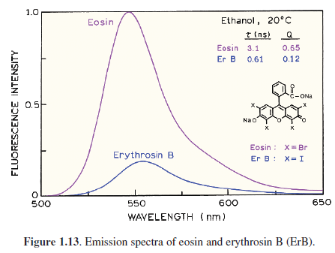
Radiative vs Non-radiative
k_{r} = Φ/τ
k_{nr} = (1 − Φ)/τ
 | k_{r} | k_{nr}
X = Br | 2.0 x 10⁸ s⁻¹ | 1.1 x 10⁸ s⁻¹
X= I | 2.1 x 10⁸ s⁻¹ | 1.4 x 10⁹ s⁻¹
Same extinction coefficient
Same radiative rate
k_{nr} larger with I

Slide 54
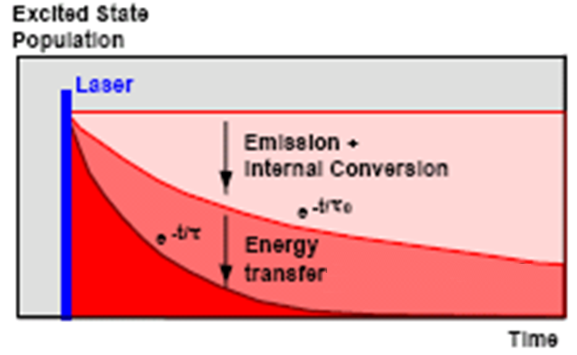
Quantum Yield and Lifetime
Unquenched Emission
k_{r}
Φ =
k_{r} + k_{ic}
τ =
1/(k_{r} + k_{ic})
With an acceptor molecule
k_{r}
Φ =
k_{ET}
k_{nr}
τ
Φ
k_{r} + k_{ic} + k_{ET}
τ =
1/(k_{r} + k_{ic} + k_{ET})

Slide 55
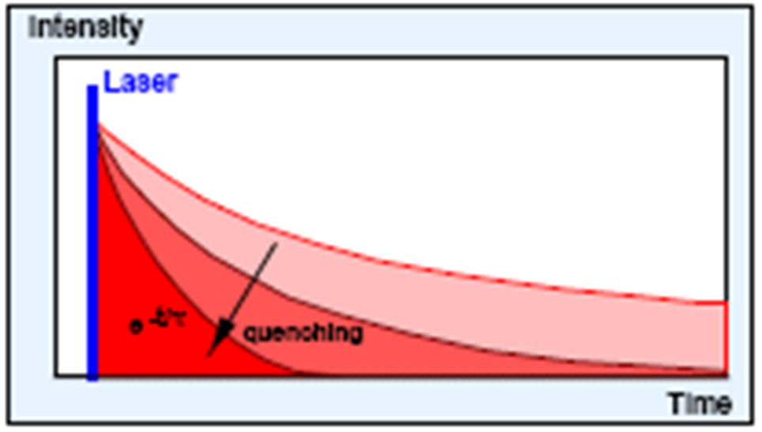
Quantum Yield and Lifetime
Unquenched Emission
k_{r}
Φ =
k_{r} + k_{ic}
τ =
1/(k_{r} + k_{ic})
With a quenching molecule
k_{r}
Φ =
[C]
k_{nr}
τ
Φ
k_{r} + k_{ic} + k_{q}[C]
τ =
1/(k_{r} + k_{ic} + k_{q}[C])

Slide 56
Side Note: Energy Gap Law
k_{r}
Φ =
k_{r} + k_{nr}
Large Gap
Small Gap
Higher energy absorption/emission
Lower energy absorption/emission
E₁
k_{nr}
E
E
E₁
k_{nr}
E₀
E₀

Slide 57
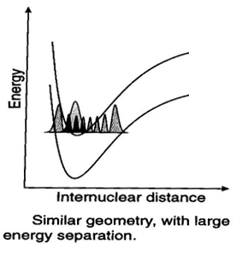
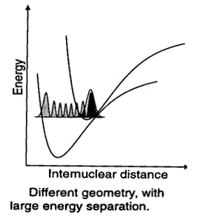
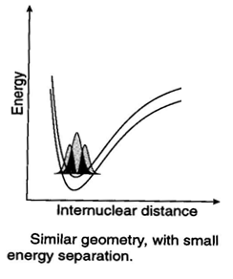
Energy Gap Law
Energy Gap (ΔE)
k_{nr}
Poor overlap
Strong overlap
S₁
S₁
S₀
S₁
S₀
S₀

Slide 58
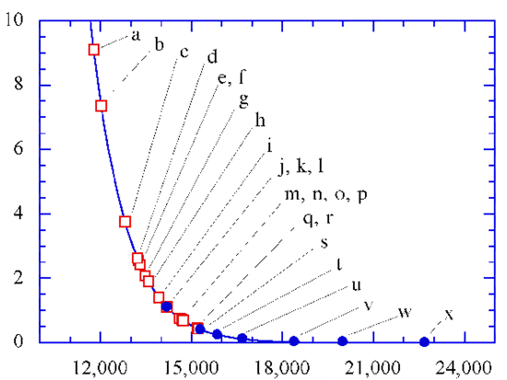
Energy Gap Law
Energy Gap (ΔE)
k_{nr}
k_{nr} (10¹¹ s⁻¹)
cm⁻¹
Φ
833
667
555
476
416
nm
Energy Gap
If you red shift emission efficiency goes down!
k_{nr} = 10¹³e^{-αΔE} (sec⁻¹)

Slide 59
Implications of Energy Gap Law
Organic Solar Cells
Charge Separation
Excitation
hν
A
C
A
C*
A⁻
C⁺
k_{cs}
k_{nr}
k_{cs}
η ∝
k_{cs} + k_{nr}
η = Solar cell efficiency
A
C*

Slide 60
Implications of Energy Gap Law
k_{cs}
Energy Gap (ΔE)
k_{nr}
k_{cs}
η ∝
k_{cs} + k_{nr}
k_{nr}
η
η Solar cell efficiency
A
C*
To increase efficiency:
Decrease ΔE
Reduce k_{nr}
Increase k_{cs}

Slide 61
Side Note: Photochemical Yield
Source
hν
Sample
# of reacted molecules
Φ =
# of photons absorbed

Slide 62
Actinometry
Reference
hν
hν
# of events
100% yield
Φ =
# of absorbed photons
# of absorbed photons = # of events
From NMR/UV-Vis/MS of the photoproduct…
Variables
Photons/second/area
Wavelength
Absorption
Extinction Coefficient
Sample
hν
hν
?% yield
From NMR/UV-Vis/MS…
# of events
3
= 60% yield
Φ =
=
# of absorbed photons
5
From Actinometer

Slide 63
Quantum Yield End
Any Questions?

